Slide 1

R Project Predictive Analysis of Anime Data (Movie/Web series)
Created by: Rahul Kumar

Slide 2

Aim of the project
For the “Anime” dataset, we need to predict the conditions that influence the “Rating” of an anime movie or web series.
This project's main purpose is to use this dataset to create a Linear Regression Business model in R-Studio and forecast the "Rating." Determine the most essential variables, interpret them, and offer practical business advice. It will assist us in the debut of our upcoming anime film/web series, which is expected to be incredibly popular.

Slide 3
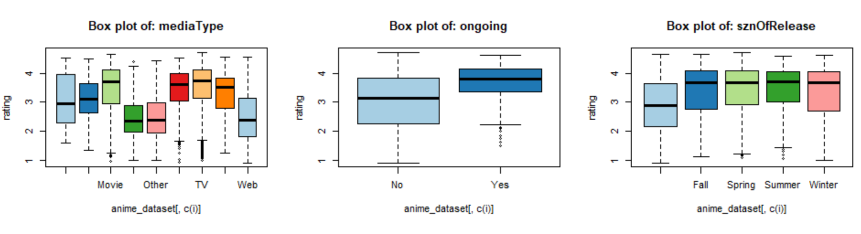
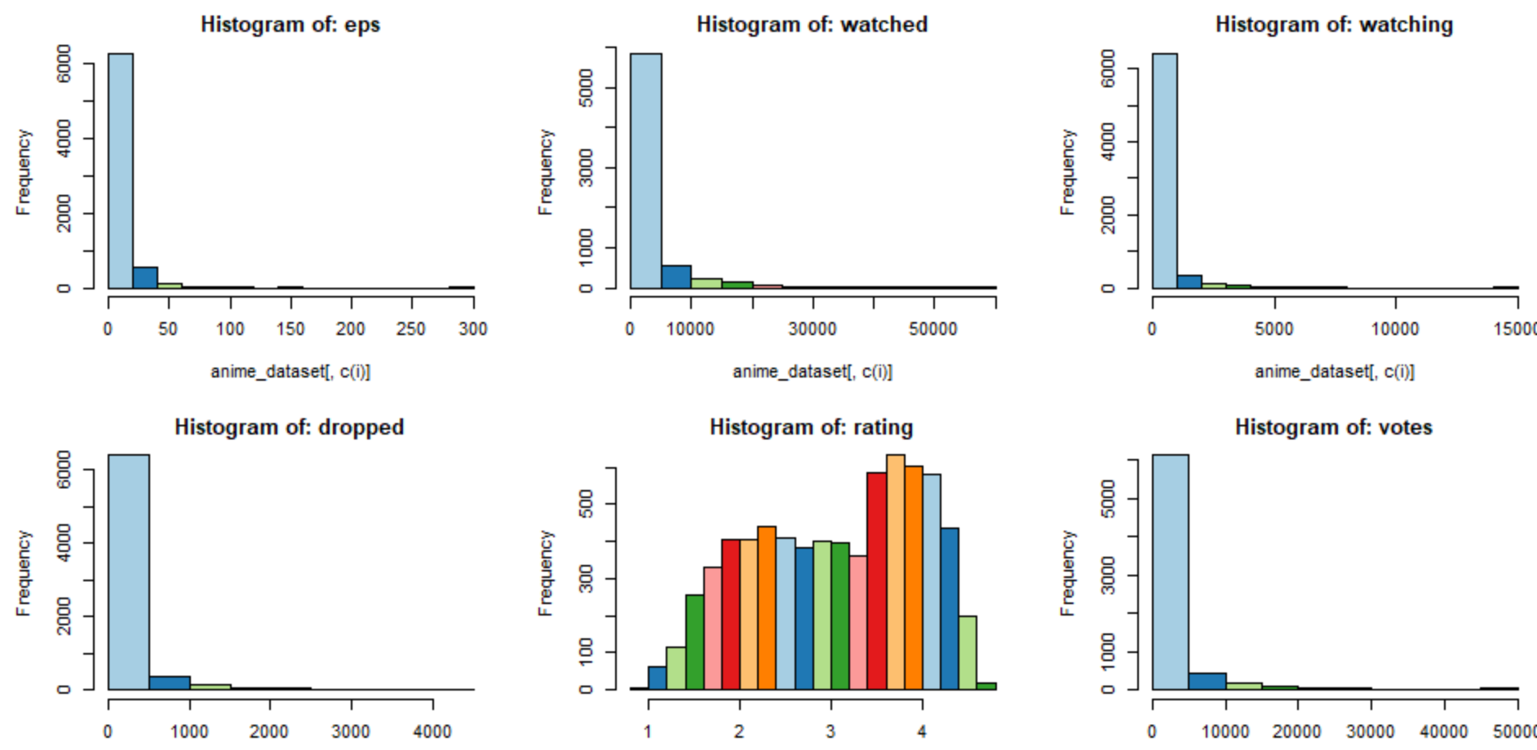
Data Visualization
Each continuous column, except for the "Rating" column, is strongly positively skewed, as can be seen in the histogram figure. As a result, we'll require a log transform to make those data normally distributed, which will help us improve the model's accuracy.

Slide 4
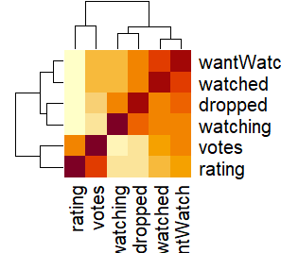
Correlation
Correlation Test:- After log transformation, "votes" columns are strongly correlated with the target variable column.
ANOVA Test:- “MediaType” & “ongoing” categorical columns are strongly correlated with “Rating” column.(cause, p-Value<0.05)

Slide 5
Significant Variables
Among the 15 Independent variables, the variables which were found to be most significant in final model are as follows:-
Votes: -The number of votes that contribute to the ratings received by different anime.
MediaType:-Format of publication of the anime releases (Web/DVD special/Movie/TV special/TV).

Slide 6
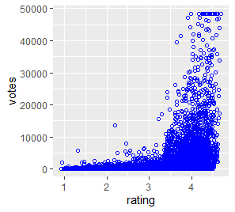
Votes vs rating
The accompanying graph shows that as the “Rating” increases, so does the number of “Votes.” As a result, these two columns have a positive correlation. Increasing the number of votes helps to raise the anime series' rating, making it more popular than others.

Slide 7
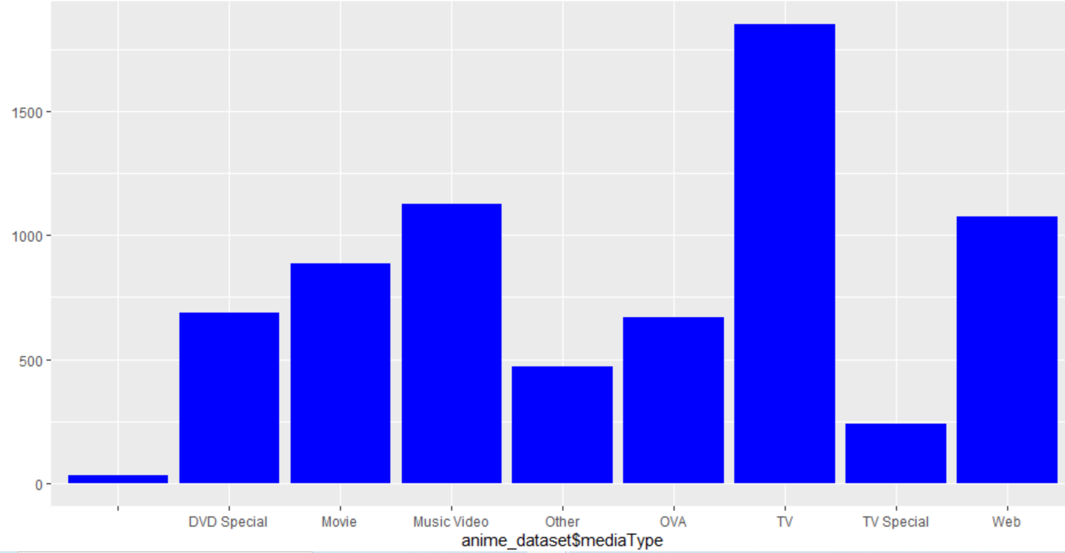
MediaType Vs rating
According to our final model, the most common mediaType categories are web and movie. According to the graph, those types have a higher rating value and popularity than others.

Slide 8
Conclusions
According to MAPE (Mean and Median error percentage), our regression model correctly predicts the outcome 82.06 percent (Mean) and 88.02 percent (Median) of the time, with error percentages ranging from 12 to 18 percent, which is rather impressive for a prediction model.
The adjusted R-square value is 0.5828, and the R-square value is 0.583. This is a good prediction model because these values are between 0.5 and 0.95.

Slide 9

Business Recommendations
When movies are released on mediaType(Web/Movie/), they have a better chance of receiving higher ratings than when they are released on MediaType (TV special/TV/DVD special), because the majority of the young generation prefers to watch on the web.
For better rating, it is required to focused on movie type –Movie , ova, Tv ,Tv Special, as this categories are famous to maximum audience.

Slide 10

Thank you

